Slide 1



FAANG

Slide 2


Slide 3
Content
Data Collection
Trading Strategy using Technical Indicators
Risk Calculation

Slide 4
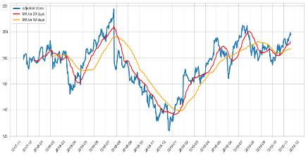
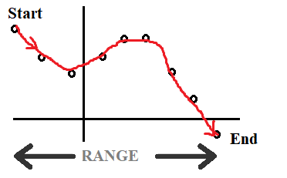



Data
Data Collection
Data Type: Date & Stock Price
Data Range: 19.11.17-19.11.19
Example: Facebook
NO NULL VALUE!!!!!!

Slide 5

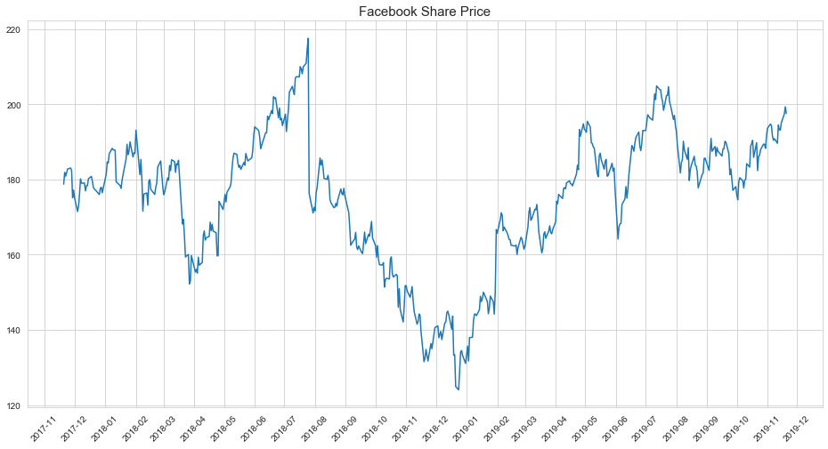

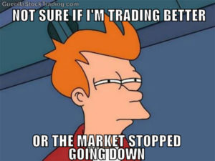
Typical Stock Graph in Financial News…

Slide 6
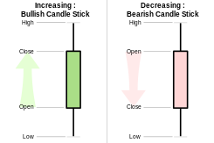
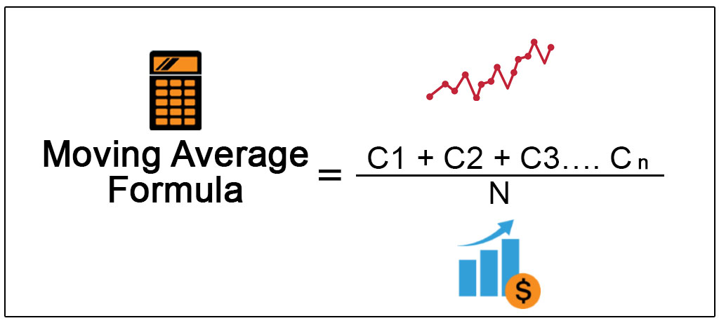
Technical Indicators
Candlestick Usage: Visualisation of the stock price movement over a certain period of time
Moving Average Usage: Identification of an underlying trend by smoothing out fluctuations in price volatility

Slide 7
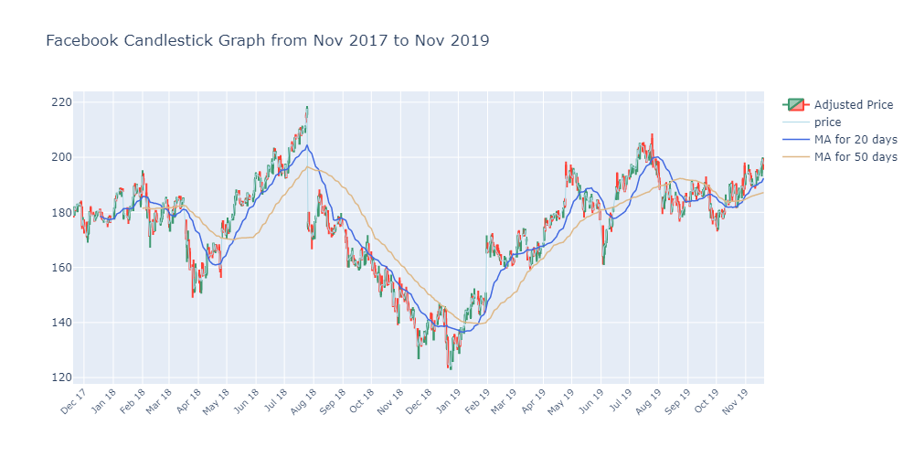
Using Technical Indicators to Identify Trade Opportunities

Slide 8
The question that is often asked by the traders…
What is the most I can - with a 95% or 99% level of confidence - expect to lose in dollars or % over the next month?
Ways to calculate it
Historical Method
Variance-Covariance Method
Monte Carlo Method

Slide 9
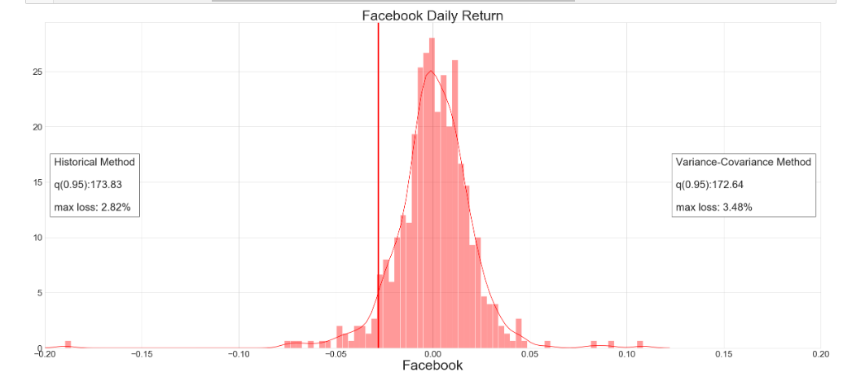
Historical & Variance-Covariance Method

Slide 10
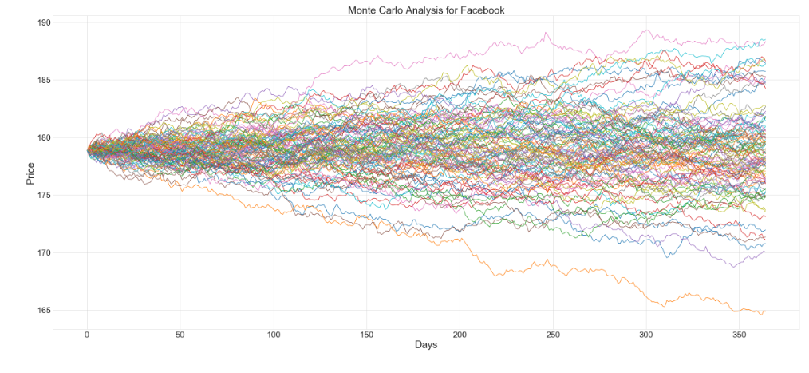

Monte Carlo Simulation

Slide 11
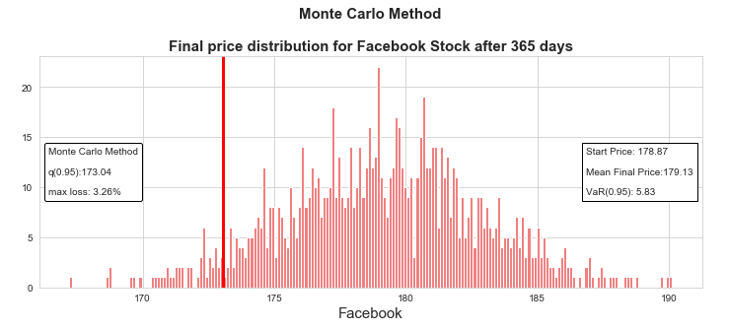
Conclusion
Referring back to our original question:
By the rule of thumb in trading, with a 95% level of confidence, we can expect that our worst daily loss in FB is 3.48%

Slide 12
To-dos
Conduct null hypothesis testing:
Did FAANG perform better S&P500?
Correlation Analysis
Variance-Covariance Calculation
Stock Optimisation using Sharpe Ratio

Slide 13
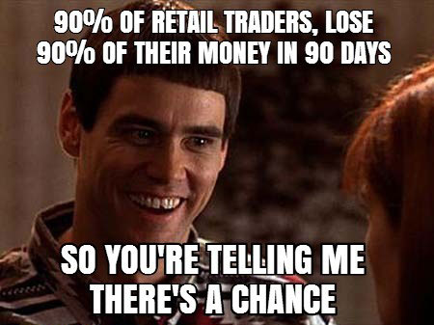
Thank you!

